Slide 1

HR Analytics:
EMPLOYEE RETENTION
GROUP - 02

Slide 2





MENTOR – BIDHAN SEN
TEAM
ANUSHKA PRATAP
PUNAM LATE
Vaishnavi Gaikwad
SIDDHI RAMANE

Slide 3


TEAM
Mahesh
SACHIN JADHAV

Slide 4
Introduction & Problem Statement
Business Objective
KPIs
Dashboard
Conclusion
AGENDA :
PRESENTED BY: ANUSHKA PRATAP

Slide 5
INTRODUCTION:
PROBLEM STATEMENT:
HR analytics involves the collection and analysis of HR-related data, including employee data, performance metrics, and other relevant data points. By using advanced analytical tools and techniques, HR analytics provides valuable insights into HR processes and trends, enabling organizations to make more informed decisions about their employees and improve overall performance.
Average attrition rate for all Departments
Average hourly rate of Male Research Scientist
Attrition rate Vs Monthly Income stats
Attrition by Marital Status
Department-wise Job Satisfaction
Count of Employees based on Educational Field
Department-wise count of Employees
Average working years for each Department
Percentage of Employees based on gender.
Attrition rate Vs Years Since last promotion
PRESENTED BY: ANUSHKA PRATAP

Slide 6
Business Objective:
The aim of this project is to analyze employee retention and attrition rates with the organization and provide insights to the HR team for developing effective retention strategies. Through data analysis and visualizations, we will identify factors that contribute to :
Employee turnover and attrition.
Evaluate the effectiveness of existing retention strategies.
To verify the satisfaction level of employee in the organization.
Provide recommendations to improve employee retention.
PRESENTED BY: ANUSHKA PRATAP

Slide 7
KPI 1 Average Attrition rate for all Departments
This KPI is to find out the
relationship between each
department and its attrition rate and here attrition rate is highest for Research & Development Department whereas lowest is for Hardware Department.
PRESENTED BY: ANUSHKA PRATAP

Slide 8
Insights from KPI 1:
We can clearly say that attrition rate of employees for every department is almost 50% which indicates that attrition rate of employees does not depends on department. So, irrespective of the department almost 50% of employees are leaving the company. The formula to calculate the attrition rate is as follow:
Attrition rate = (Number of employees who have “Yes” status/ Count of Total Employees
From this calculation and visualization we concluded that we must make strong strategies to minimize attrition rate and improve our company’s Employee retention so that we can balance the company’s growth and right talent.
PRESENTED BY: ANUSHKA PRATAP

Slide 9
KPI 2 Attrition Rate Vs Monthly Income Stats
This KPI is to find out the relation the between monthly income and Attrition rate.
PRESENTED BY: ANUSHKA PRATAP

Slide 10
Insights from KPI 2:
Based on our analysis and visualization, it is evident that the lowest attrition rate of 49.80%, with an average monthly income of Rs. 31000 to 40,ooo. On the other hand, the highest attrition rate of 51.26%, with an average monthly income of Rs. 50000 or above
PRESENTED BY: ANUSHKA PRATAP

Slide 11
KPI 3 Avg Working hours Department- wise
Insights from KPI 3:
From this we can see the average working years in SALES department is high as compared to the rest of the departments and lowest is for Research & Development Department.
From the analysis we can conclude that average working years is approximately 21 for all the departments.
PRESENTED BY: ANUSHKA PRATAP

Slide 12
KPI 4 Average Hourly rate of Male and Female
In this KPI to find out the gender pay gap difference between the time of working. The gender pay gap is calculated as the difference between average hourly earnings (excluding overtime) of men and women as a proportion of average hourly earnings (excluding overtime) of women’s earnings.
PRESENTED BY: PUNAM LATE

Slide 13
Insights
from KPI 4:
In this KPI the gender pay gap is the difference between the average hourly earnings of men and women in the workforce. The most common way to calculate an hourly rate is to divide the annual salary by the number of hours worked .
An hourly rate is a measure used to calculate an employee’s compensation. It indicates how much you would have to charge for a specific job. An hourly rate is quoted in dollars and cents per hour
PRESENTED BY: PUNAM LATE

Slide 14
KPI 5 Attrition rate vs Years since Last Promotion
In this KPI card we find the relationship between attrition rate and years since last promotion. It is an important topic in human resources.
PRESENTED BY: PUNAM LATE

Slide 15
Insights from KPI 5:
It’s important to note that the attrition rate is influenced by various factors such as job satisfaction, salary level, and employee performance ratings.
The formula to calculate the attrition rate is as follow:
Attrition rate = (Number of employees who left / Average number of employees in the period) x 100
PRESENTED BY: PUNAM LATE

Slide 16
KPI 6 Count of Employees based on Educational Field
This KPI is to find out the Count of Employees based on Educational Field
PRESENTED BY: VAISHNAVI GAIKWAD

Slide 17
Insights from KPI 6:
Based on our analysis and visualization, we can see that there are less employees from Marketing Field i.e 8197 . And more employees from Medical field i.e 8607 . Average Count of Employees in each educational field is 8333.
PRESENTED BY: VAISHNAVI GAIKWAD

Slide 18
KPI 7 Department-wise Job Satisfaction
This KPI is to provide valuable insights into the overall health and performance of an organization.
PRESENTED BY: SIDDHI

Slide 19
Insights from KPI 7:
After Analysis it is seen that employee from developer department are more satisfied as comparison to the employee from sales department who has lowest job satisfaction.
PRESENTED BY: SIDDHI

Slide 20
KPI 8 Department-wise Count of Employees
This KPI is to provide valuable insights into various department of an organization and workforce management.
PRESENTED BY: SIDDHI

Slide 21
Insights from KPI 8:
It determine the distribution of employees across different departments . Also identify departments with a high or low number of employees.
it is evident that the Hardware Department has the lowest employee count of 8169. On the other hand, the Sales Department has the highest employee count of 8453.
PRESENTED BY: SIDDHI

Slide 22
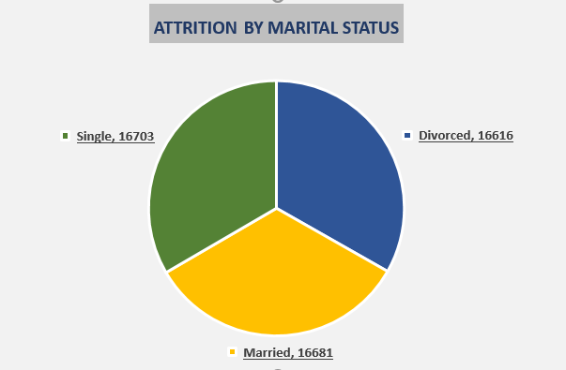
KPI 8 Attrition By Marital Status
This KPI is to assess the impact of marital status on employee turnover within an organization.
PRESENTED BY: SACHIN JADHAV

Slide 23
Insights from KPI 8:
It seems that Attrition rate of the employees who are singles is highest 16703 followed by married and divorced 16691,16616 respectively.
We have to develop targeted retention strategies and need to customize interventions and policies to address the specific needs and concerns of employees in each marital status group.
PRESENTED BY: SACHIN JADHAV

Slide 24
KPI 10 Percentage of Employees based on Gender
This KPI is used to find the percentage of employees based on gender
PRESENTED BY: MAHESH

Slide 25
INSIGHTS FROM KPI 10
Based on our analysis and visualization I came to a conclusion regarding percentage of employees based on gender. In the given data there males are somewhat higher than females. There are 25059 males are present and count of females are 24941 and when it convers to percentage male employees percentage is nearly 50.12% and the female employees percentage is nearly 49.88%
PRESENTED BY: MAHESH

Slide 26
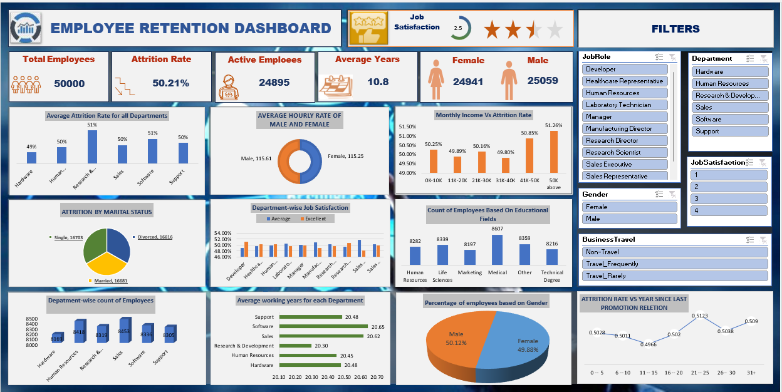

Slide 27
Conclusion :
The attrition rate is 50.21%, which means that over half of the employees leave the company each year. The attrition rate is higher for males (51.50%) than for females (50.16%). The attrition rate is also higher for employees who have been with the company for less than 10 years (54.00%) than for employees who have been with the company for more than 10 years (43.80%).
Job satisfaction is highest for employees in the Sales department (123.4) and lowest for employees in the Human Resources department (113.25). Job satisfaction is also higher for employees who have been with the company for less than 10 years (115.61) than for employees who have been with the company for more than 10 years (113.25).
The average hourly rate is $1.00. The hourly rate is higher for males ($1.15) than for females ($1.13). The hourly rate is also higher for employees in the Software department ($1.20) than for employees in the Support department ($0.51).
The Support department has the most employees (2048), followed by the Software department (2010) and the Research & Development department (2012). The Human Resources department has the fewest employees (147).
PRESENTED BY: ANUSHKA PRATAP

Slide 28
THANK YOU

